Slide 1
INTEGRATED SUMMATIVE TASK 3
TEAMWORK, TEAM EFFECTIVENESS AND INNOVATION

Slide 2




Team Name: Codebusters
The survey was conducted on the following team members:
Technical Lead Developer
Senior C# Developer
Senior C# Developer
Intermediate SQL Developer

Slide 3
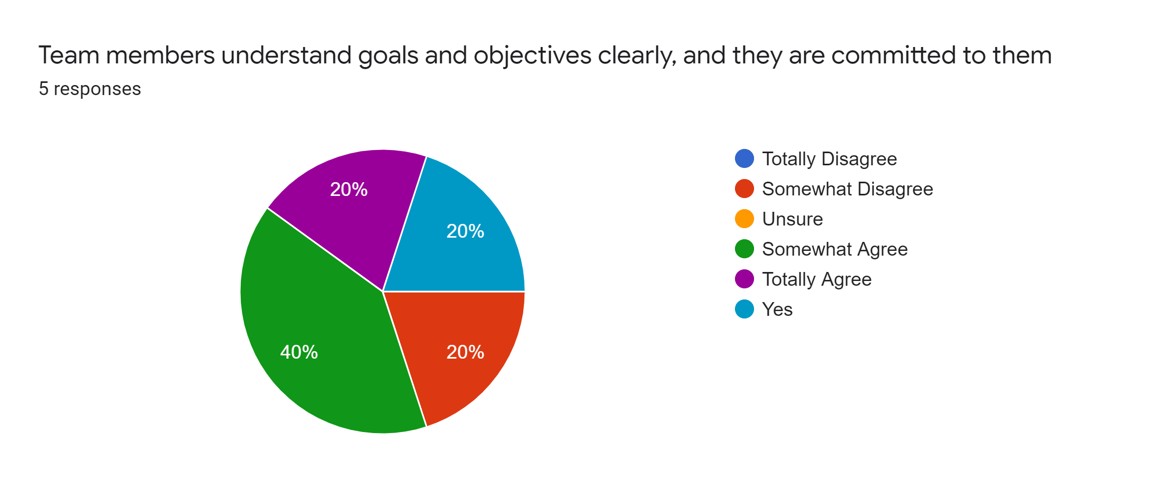
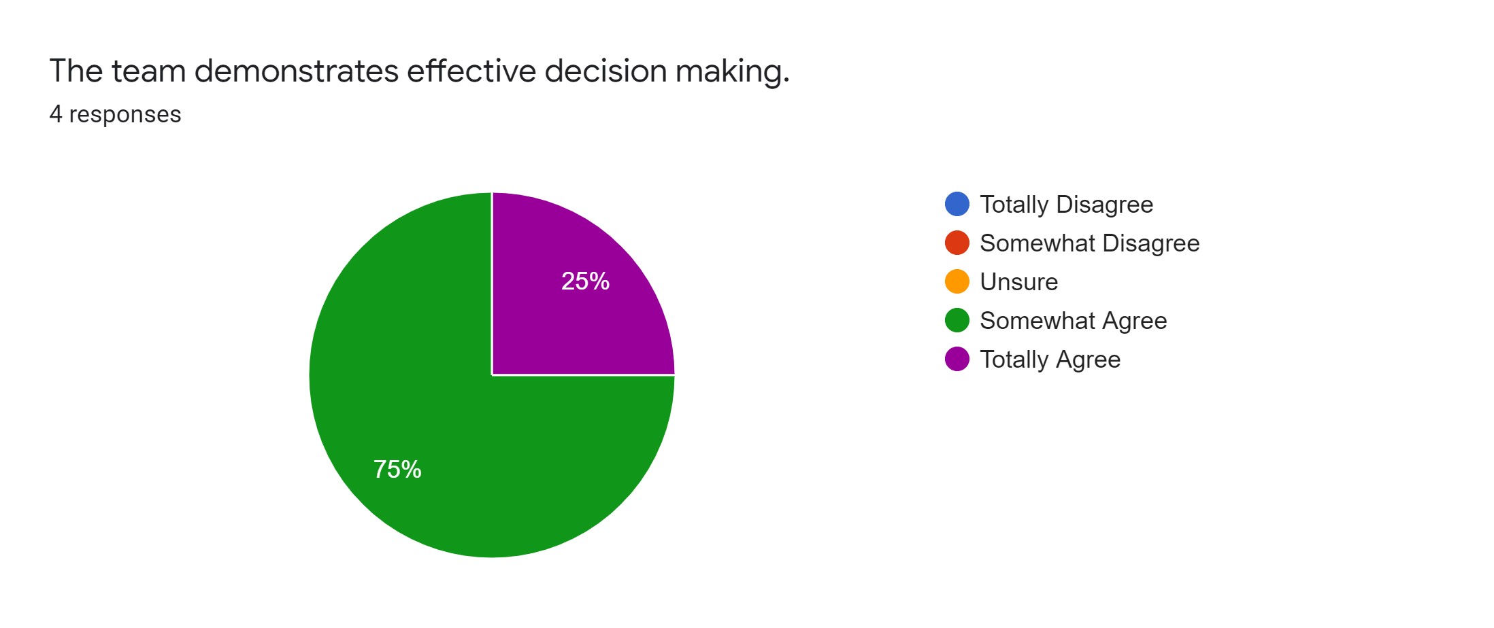

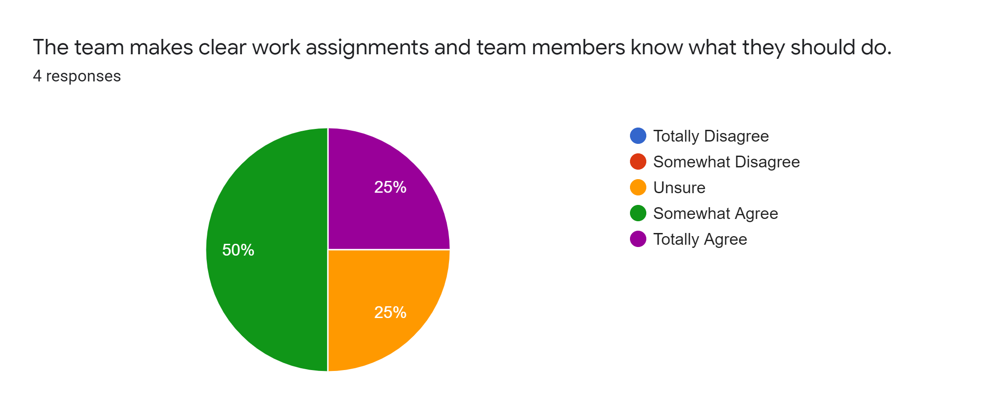
Survey Questions and Results

Slide 4
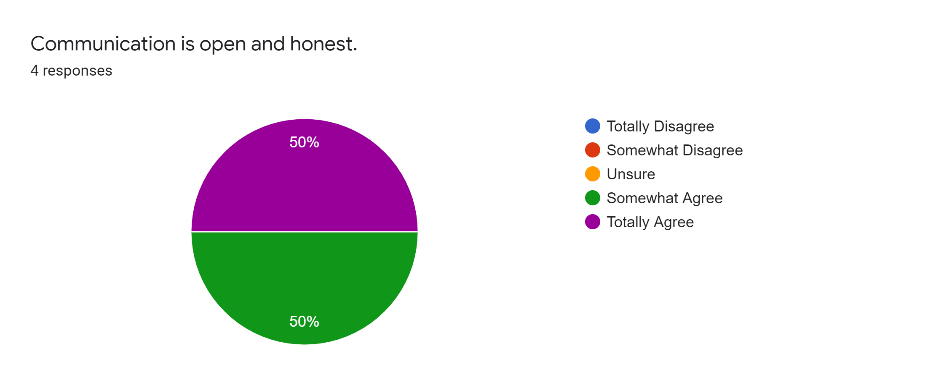
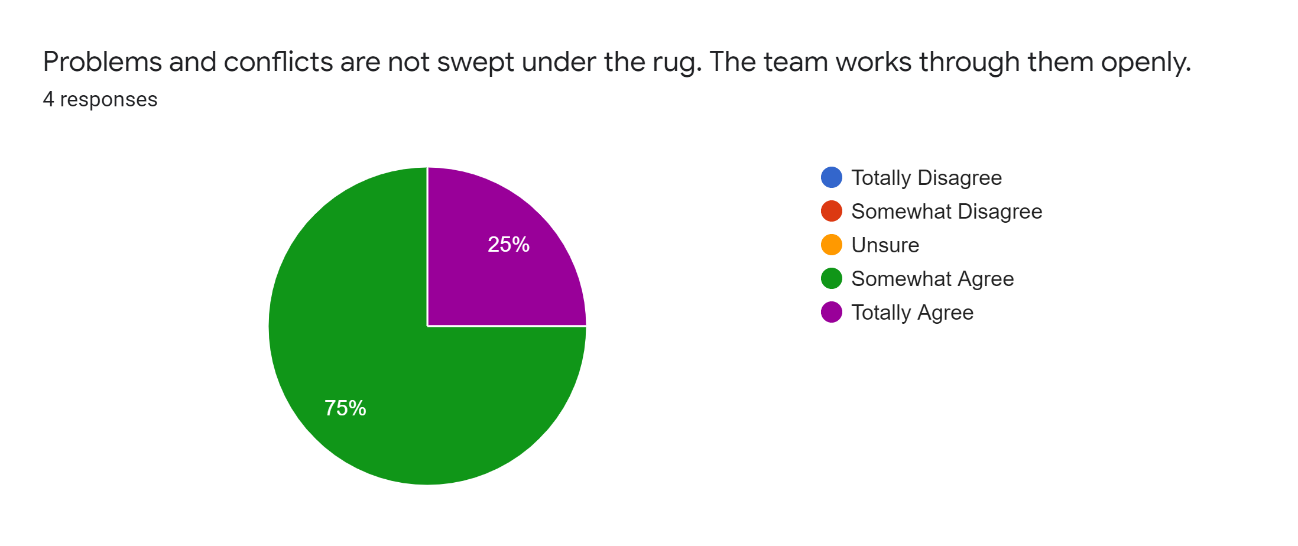
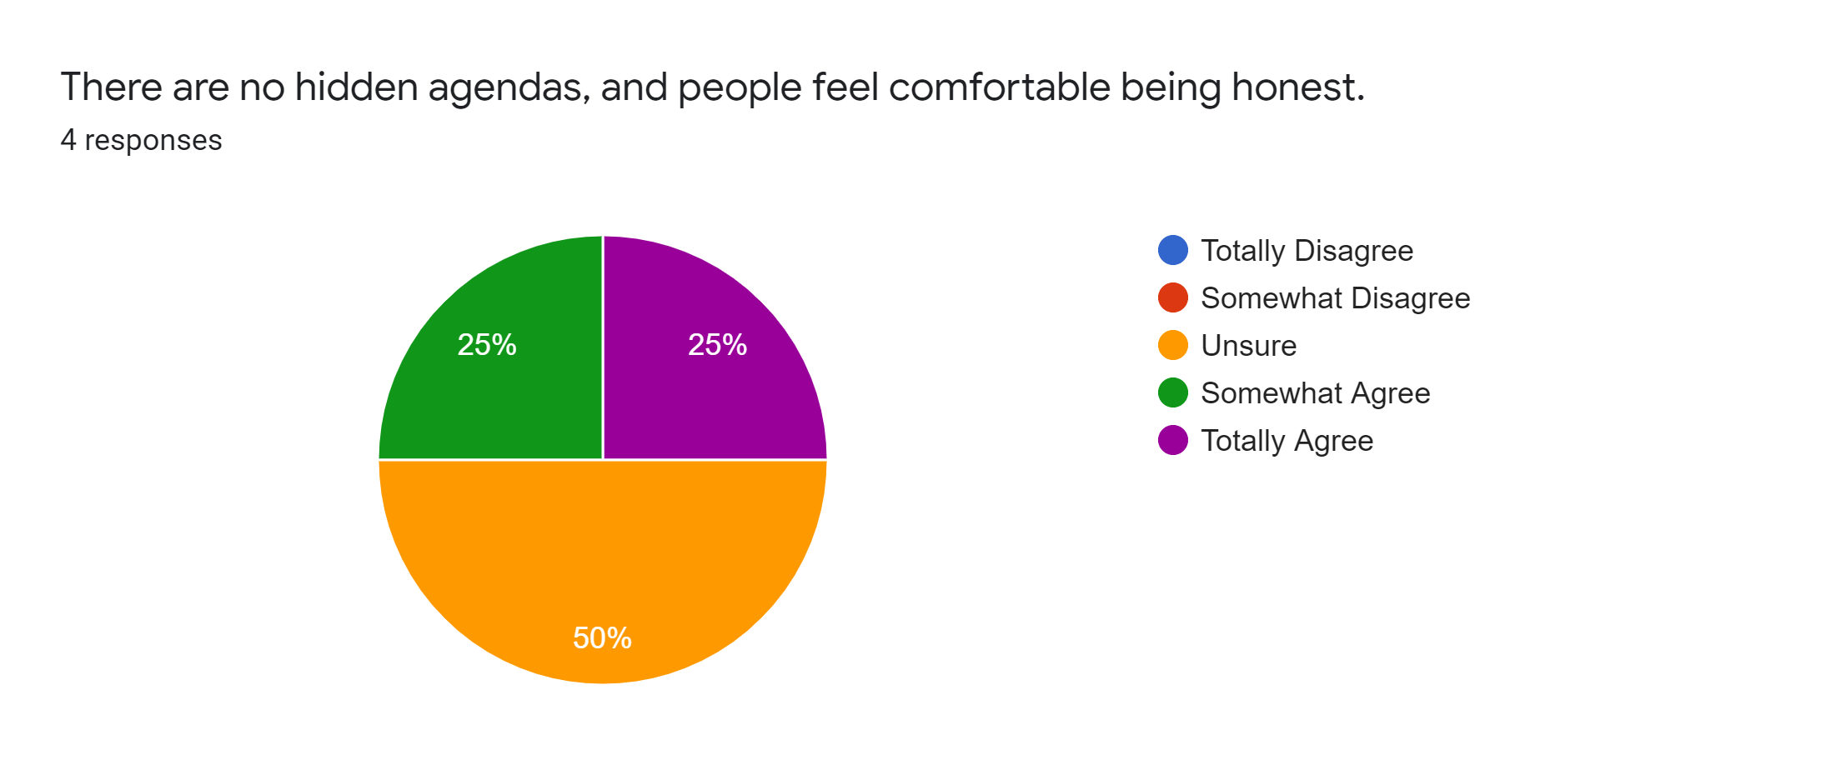
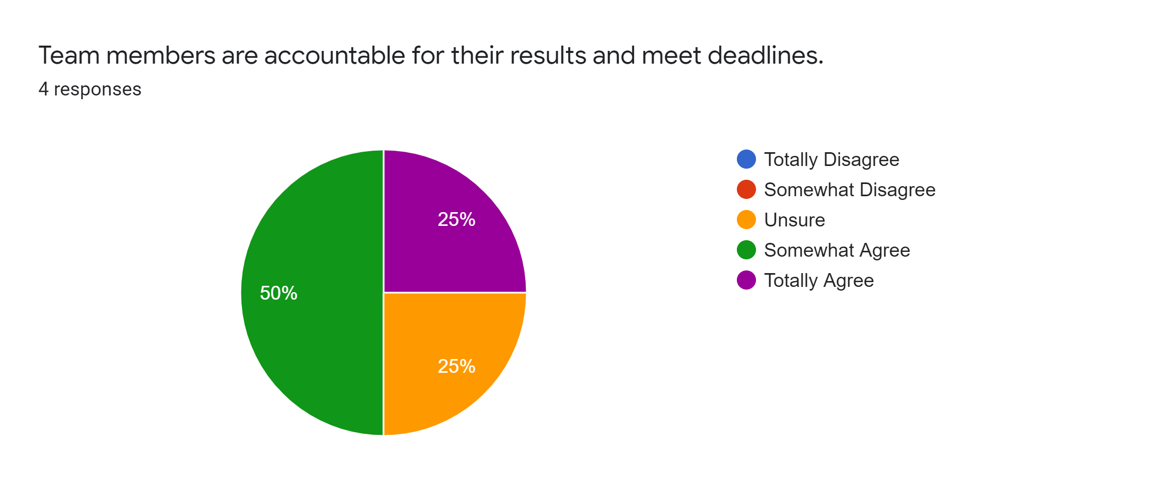
Survey Questions and Results

Slide 5

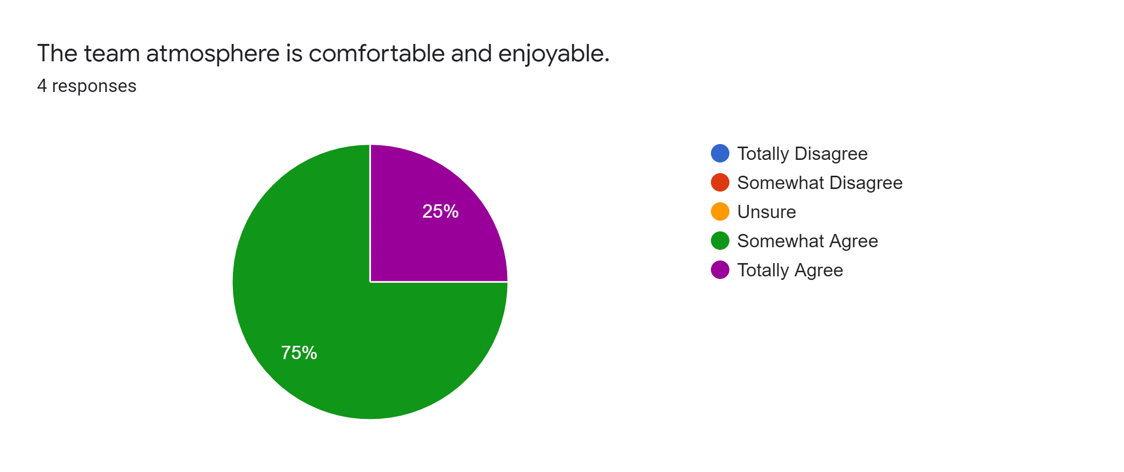

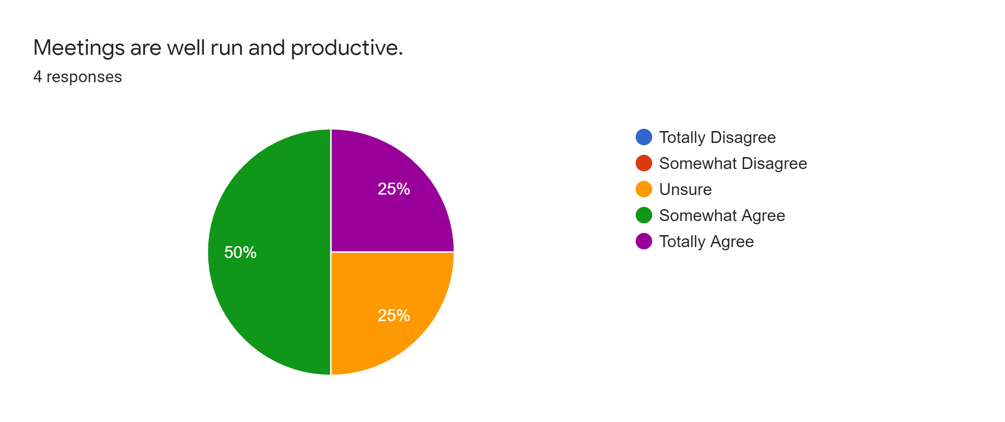
Survey Questions and Results

Slide 6
Feedback and Recommendations
The following is based on a General Overview
Codebusters demonstrates positive team dynamics.
Most of the team members are less than a year in their new positions and still getting used to the domain.
More team member engagement is necessary so communications can be more fluid and possible Team Building.
More domain training should be given to the newer members.
What’s working | What’s not
The strategy with regards to decision making seems to be on the right track and generally effective. | ¼ of the team do not clearly understand their objectives and goals. Communication and understanding of team goals impacts team performance, and this should therefore be given priority.
The team generally feels that their opinions are heard when participating as a group. | ¼ of the team are unsure of their work assignments. This again speaks to the need for clear communication of goals and objectives.
The communication that does happen within the team is perceived as open and honest. Problems are dealt with as opposed to being hidden. | There is element of uncertainty with regards to accountability within the team. This would need further investigation to determine the root of uncertainty, and thereafter address it.
There is a supportive culture with regards to team members being safe to make mistakes without fear of the “blame game”. | Meetings may not all be perceived as well conducted, or necessary as ¼ of the team have indicated uncertainty in that area. Suggest that meetings be held only where required, and that each meeting is chaired correctly (i.e., agenda, structure etc.)

